Slide 1
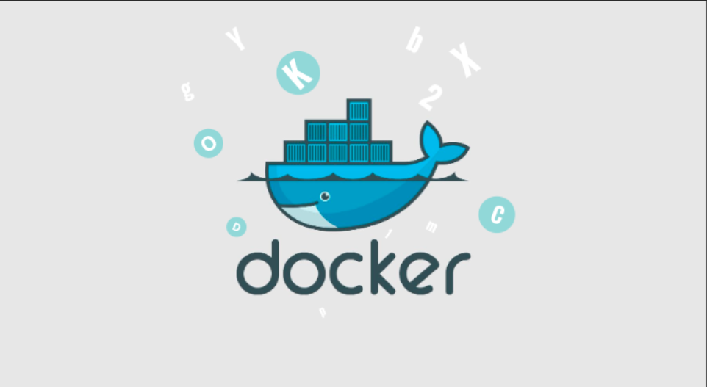
INTRODUCTION TO DOCKER

Slide 2
What is Docker ?
Docker is a containerization tool.
To create , run and deploy the applications into the containers.
Container is package of code, libraries and dependencies required for application to run.
Docker makes it easy to create, run and deploy applications in the form of containers.
Using Docker containers you can run applications on-premises , local host on cloud anywhere.

Slide 3
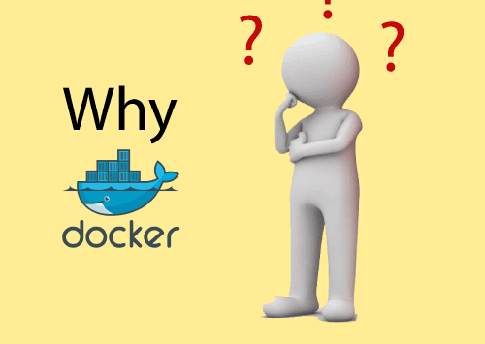
Docker is designed to benefit both the Developer and System Administrator. There are the following reasons to use Docker -
Docker allows us to easily install and run software without worrying about setup or dependencies.
Developers use Docker to eliminate machine problems, i.e. "but code is worked on my laptop." when working on code together with co-workers.
Operators use Docker to run and manage apps in isolated containers for better compute density.
Enterprises use Docker to securely built agile software delivery pipelines to ship new application features faster and more securely.
Since docker is not only used for the deployment, but it is also a great platform for development, that's why we can efficiently increase our customer's satisfaction.

Slide 4
Docker Advantages
There are the following advantages of Docker -
It runs the container in seconds instead of minutes.
It uses less memory.
It provides lightweight virtualization.
It does not a require full operating system to run applications.
It uses application dependencies to reduce the risk.
Docker allows you to use a remote repository to share your container with others.
It provides continuous deployment and testing environment.

Slide 5
Disadvantages
It increases complexity due to an additional layer.
In Docker, it is difficult to manage large amount of containers.
Some features such as container self -registration, containers self-inspects, copying files form host to the container, and more are missing in the Docker.
Docker is not a good solution for applications that require rich graphical interface.
Docker provides cross-platform compatibility means if an application is designed to run in a Docker container on Windows, then it can't run on Linux or vice versa.

Slide 6
Docker Features
Although Docker provides lots of features, we are listing some major features which are given below.
Easy and Faster Configuration
Increase productivity
Application Isolation
Swarm
Routing Mesh
Services
Security Management

Slide 7
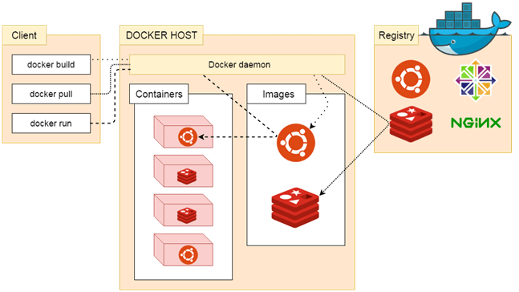
Docker Architecture

Slide 8
Docker follows Client-Server architecture, which includes the three main components that are Docker Client, Docker Host, and Docker Registry.
When developers build the software application, they install it on dev servers to test it. Then it is handed over test team, it is again installed on a test environment, and the test team tests the application. Finally, once everything is “go green” it is installed and deployed to the production environment.
In this process, the same application was getting configured and set up in different environments which is time-consuming and tedious. That is where Docker comes into the picture.
With the help of Docker, we can create a software package of our application called an image and this image can be deployed just with a single command on different environments as long as the environment also has Docker installed on it. This saves a lot of time deploying the Application in different environments.

Slide 9
Docker Commands
docker images: Docker images will list all the images which are pulled or build in that docker host.
docker pull: Docker pull will the docker images from the dockerhub.
docker run: Docker run will run the docker image as an container.
docker ps: Docker run will list all the containers which are running in the docker host.
docker stop: Docker stop will stop the docker container which are already running.
docker rm: Docker rm command will remove the containers which are in the stop condition.

Slide 10
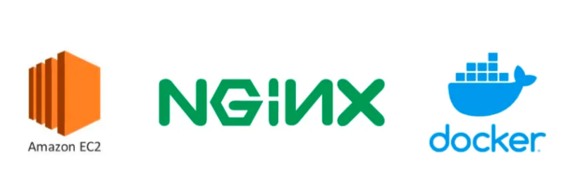
Now here we have create nginx image

Slide 11
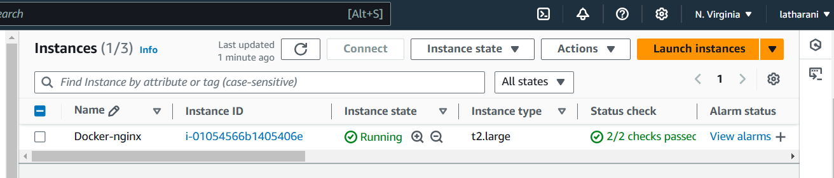
Here are a few steps we can follow to create a docker image with Nginx :
Install Nginx into EC2 instance :
Here , lauch one EC2 instance on AWS cloud.

Slide 12
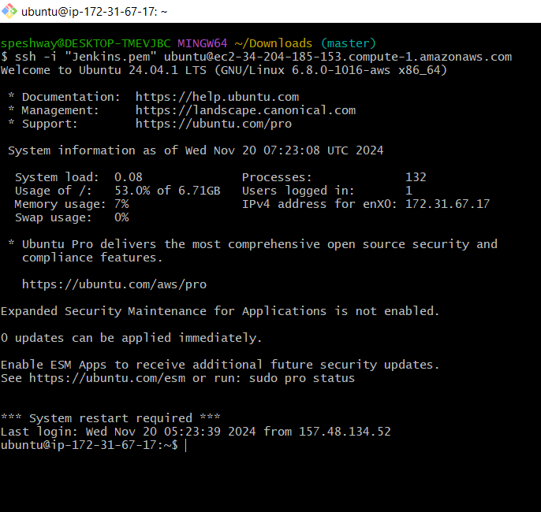
Connect to our EC2 instance via SSH.

Slide 13
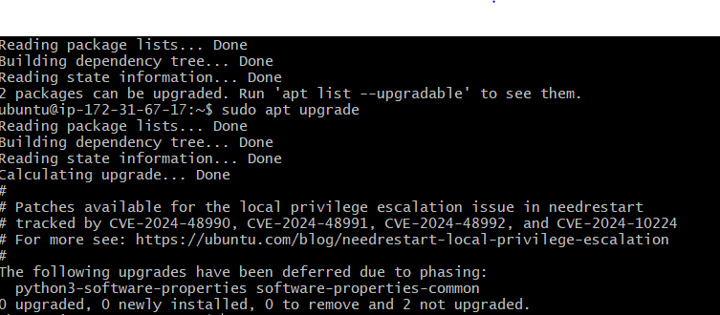
Update the package list and upgrade the system:
$ sudo apt update $ sudo apt upgrade

Slide 14
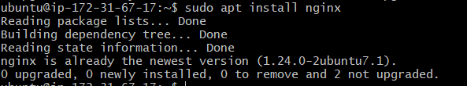
Install Nginx using the following command:
$ sudo apt install nginx

Slide 15
Once the installation is complete, start the Nginx service using the following command:
$ sudo systemctl start nginx
$sudo systemctl enable nginx
That’s it! Nginx is now installed and running on the EC2 instance.

Slide 16
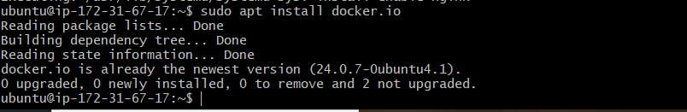
Now install Install Docker on the EC2 instance:
Install Docker using the following command:
$ sudo apt install docker.io

Slide 17
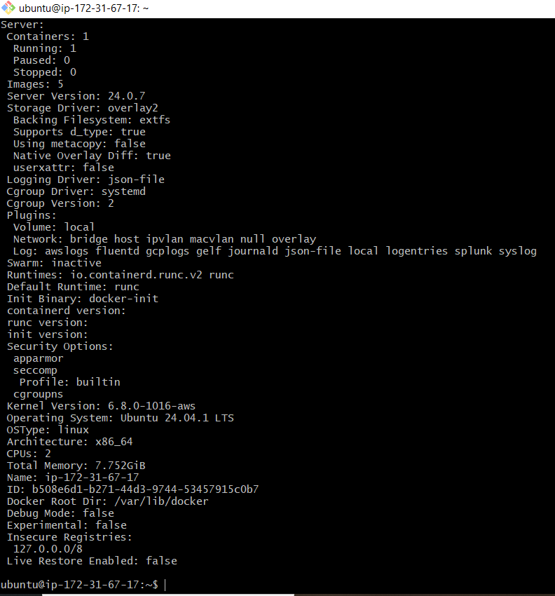
Once the installation is complete, start the Docker service using the following command:
$ sudo systemctl start docker
Verify that Docker is running by running the following command:
$ sudo docker info

Slide 18

By default, the docker the command can only be run by the root user. To run Docker commands as a non-root user, we can add our user to the docker group using the following command:
$ sudo usermod -aG docker $USER
Replace $USER with the actual username.
5. To apply the changes, log out and log back into our EC2 instance.
That’s it! Docker is now installed and running on the EC2 instance.

Slide 19
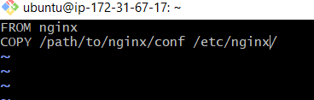
Now Configure Docker Image with Nginx :
Once Docker is installed, we can create a new Dockerfile that describes how to build our Nginx image. We can use a text editor to create a file called “Dockerfile” in a directory of our choice, with the following contents:
FROM nginx COPY /path/to/nginx/conf /etc/nginx/
This Dockerfile will create a new image based on the official Nginx image and copy the Nginx configuration files into the image.

Slide 20
Build the Docker image by running the following command in the directory where our Dockerfile is located:
$ docker build -t my-nginx-image
This command will build the Docker image using the Dockerfile and tag it with the name “demo-test-image”.
Once the image is built, we can run a Docker container based on the image using the following command:
$ docker run -d -p 80:80 demo-test-image
This command will start a Docker container based on the demo-test-image image and map port 80 on the container to port 80 on the host machine.
4. Finally, we can verify that the Nginx server is running by accessing the public IP address of our EC2 instance in a web browser.
If everything is working correctly, we should see the default Nginx welcome page.

Slide 21
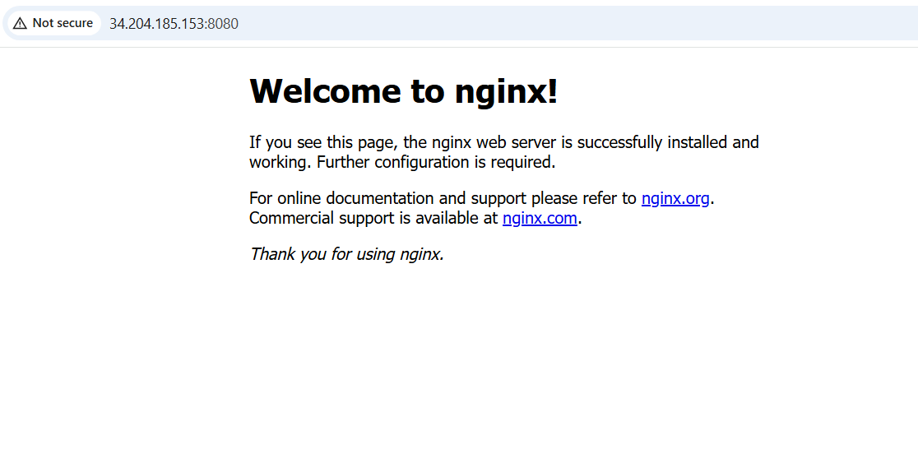

Slide 22
conclusion
Finally, we have done the NGINX image using docker on aws cloud .

Slide 23


